Slide 1

Marketing 101
Assignment
Name:-
Akshit Singhal
2) Prudhviteja Cherukuri
3) Sai Jyosthna Yenumala
4) Tameem Attar
Prepared by Team3
March 20th, 2023

Slide 2
Agenda
Introduction
Executive summary
Personas of the segments

Slide 3
Introduction
Medicare is a national health insurance program in the United States that provides coverage for people aged 65 and older, as well as those with certain disabilities and medical conditions. It is administered by the federal government and funded through payroll taxes, premiums, and general revenue.
Medicare has four parts:
Part A (hospital insurance)
Part B (medical insurance)
Part C (Medicare Advantage plans)
Part D (prescription drug coverage)

Slide 4
Executive summary
In this assignment, we were tasked with analyzing the data to create personas for six different segments. Through our analysis, we deeply analyzed 12 different key dimensions such as Financials, Demographics, Market Trend etc.
We identified demographic characteristics, interests, behaviors, and pain points for each segment. Based on this information, we developed detailed profiles that represent each segment's unique needs, preferences, and attitudes.
The six segment that we analyzed are:-
Fitness and Nutrition Savvy Consumers
Active Aging Consumers
Health-Conscious Retirees
Offline Elderly Shoppers
Richie Rich
Household Managers

Slide 5







Fitness and Nutrition Savvy Consumers
Avg Age – 50
18-65 > 60%
Avg Income $80K , 40% earn more than avg income
25% have college degree
55% are likely to engage
in Sports activities
90% likely to donate
40% are likely to ailment to disease
This segment of people are middle-class consumers who prioritize health and wellness.
They are not brand loyalists and make value-based purchasing decisions.
Most of them are married and they are interested in fitness and sports activities, especially yoga.
They read medical and nutrition-related books and are active on social media.
They are likely to have a retirement savings account, a mortgage, and insurance.
A significant portion of the segment consists of professionals and business owners, they are mindful of their finances and are thrifty in their purchasing decisions.
Targeting strategy - Leverage social media platforms, especially Facebook, to reach a significant portion of the segment that is active on social media.

Slide 6

Active Aging Consumers
Avg Age – 77
60% older than 77
Avg Income $30K , 60% earn less than average income
12% have college degree
40% are likely to spend
in Sports activities
80% likely to donate
20% are likely to ailment to disease
This segment of people are lower-middle-class, online shoppers who are not brand loyalists.
They are married, with a significant portion retired, and have a high level of interest in nutrition and fitness.
They are not active on social media.
They are likely to purchase affordable health insurance and are more likely to upgrade their health insurance plans.
A majority of this group is made up of old people who are not likely to take vacations and are less likely to have retirement savings accounts, mortgages, or insurance.
Targeting strategy - Partner with healthcare providers that specialize in senior care and offer additional benefits, such as discounts on gym memberships or wellness programs.

Slide 7

Health-Conscious Retirees
Avg Age – 75
50% are older than 75
Avg Income $85K , 50% earn less than average income
35% have college degree
65% are likely to spend
in Sports activities
98% likely to donate
25% are likely to ailment to disease
This segment are typically upper middle class to wealthy individuals who prioritize fitness and nutrition.
They are IRA spenders, married, and not brand loyal.
They are likely to read medical and nutrition-related books and have reported health problems.
A significant portion of the segment is retired or own their own businesses. They are less likely to have a retirement savings account, a mortgage, or insurance, but are 50% likely to buy long-term care plans.
This segment is less active on social media and tends to upgrade their health insurance plans.
They are likely to upgrade/buy their health insurance by themself.
Targeting strategy - As this segment may be less brand loyal, healthcare insurance companies can simplify their insurance plan options to make it easier for this segment to compare and choose the right plan..

Slide 8

Offline Elderly Shoppers
Avg Age – 77
55% are older than 75
Avg Income $75K , 25% earn less than average income
35% have college degree
20% are likely to spend
in Sports activities
40% likely to donate
1% are likely to ailment to disease
This segment are typically lower middle-class individuals.
They are married and generally spend more time with their families.
They are not likely to read books.
A significant portion of the segment is retired . They are less likely to have a retirement savings account, a mortgage, or insurance, and 50% likely to get health insurance from labour-union or small to mid-organization.
This segment is less active on social media and don't like to go for travelling or vacation.
They segment is the miser who generally from offline stores and spend only on essential needs
Targeting strategy -Since this segment is less likely to prioritize health and fitness, they may value convenience when it comes to healthcare. The insurance company can offer telemedicine services, home visits by doctors, and other convenient options that make it easier for this segment to access healthcare.

Slide 9

Richie Rich
Avg Age – 70
50% are older than 70
Avg Income $200K , 55% earn less than average income
60% have college degree
20% are likely to spend
in Sports activities
65% likely to donate
5% are likely to ailment to disease
This segment of people is affluent, fashion-conscious, and brand loyalists who prioritize their health and fitness.
They are typically married and aged, with a significant percentage being technical professionals or business owners.
They tend to upgrade their healthcare plans and are likely to pay premiums themselves, with many obtaining health insurance through their employers.
While they enjoy vacations and leisure activities, they are more active on Facebook and are unlikely to play sports.
Retirement savings, mortgages, and insurance are also not priorities for them.
Targeting strategy -To reach this audience, insurance companies can use targeted marketing strategies, such as sponsoring health-related events or collaborating with luxury brands to create co-branded campaigns.

Slide 10
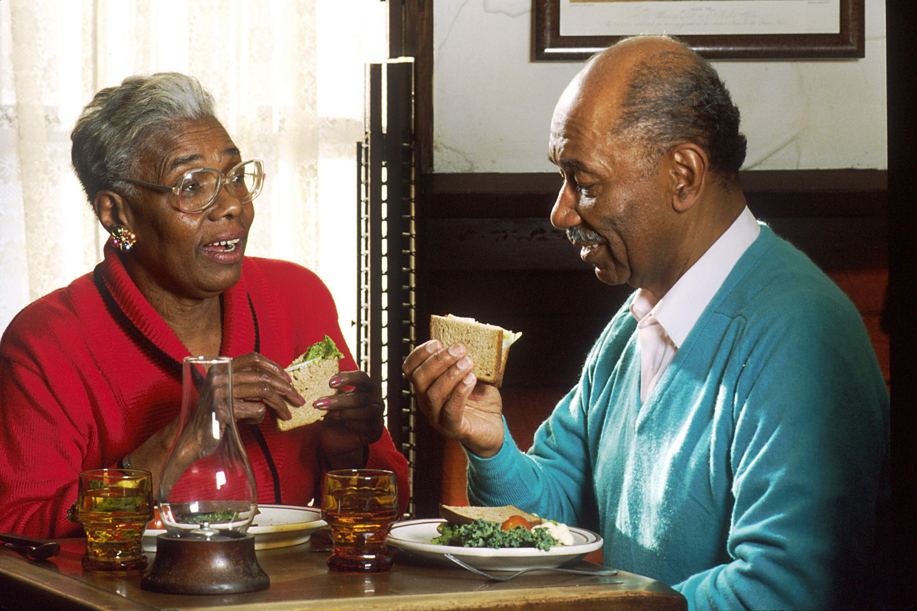
Household Managers
Avg Age – 75
60% are older than 75
Avg Income $40K , 75% earn less than average income
60% have college degree
20% are likely to spend
in Sports activities
65% likely to donate
5% are likely to ailment to disease
This segment consists of middle-class individuals, mostly old people, who have a zone of contentment and extra time on their hands.
Mostly are female and housemaker
They are not brand loyalists and have less purchases both online and offline, but do not have many financial obligations such as a mortgage, insurance, or retirement savings.
They prefer a simple and comfortable lifestyle and are not interested in vacations.
They are likely to get their health insurance from small to mid-size employers and do not want to upgrade their plan.
Targeting strategy - Highlight the affordability of their plans, Consider partnering with retirement communities or senior centers to offer health insurance plans specifically tailored to the needs of this segment

Slide 11
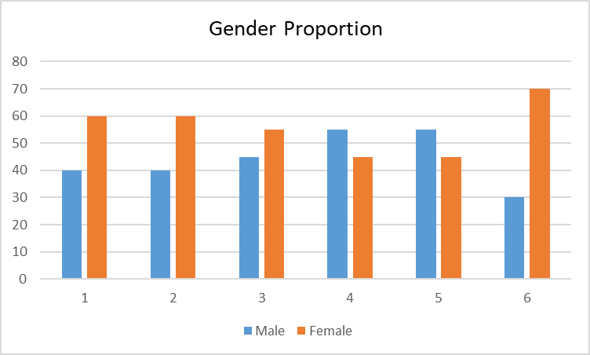
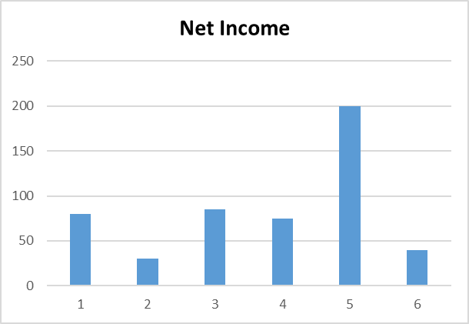
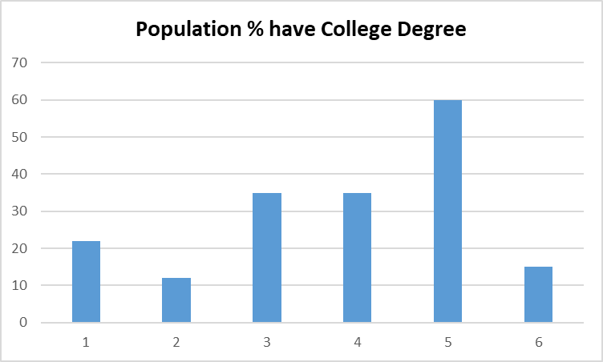
Comparison between different Segments

Slide 12
Thank You

